Slide 1

Conditional GAN – Week 6
Ahsan Lohdi, Yang An
Technical University of Munich
Department of Informatics
Computer Vision Group
Garching, 04. June 2019

Slide 2
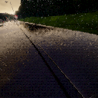
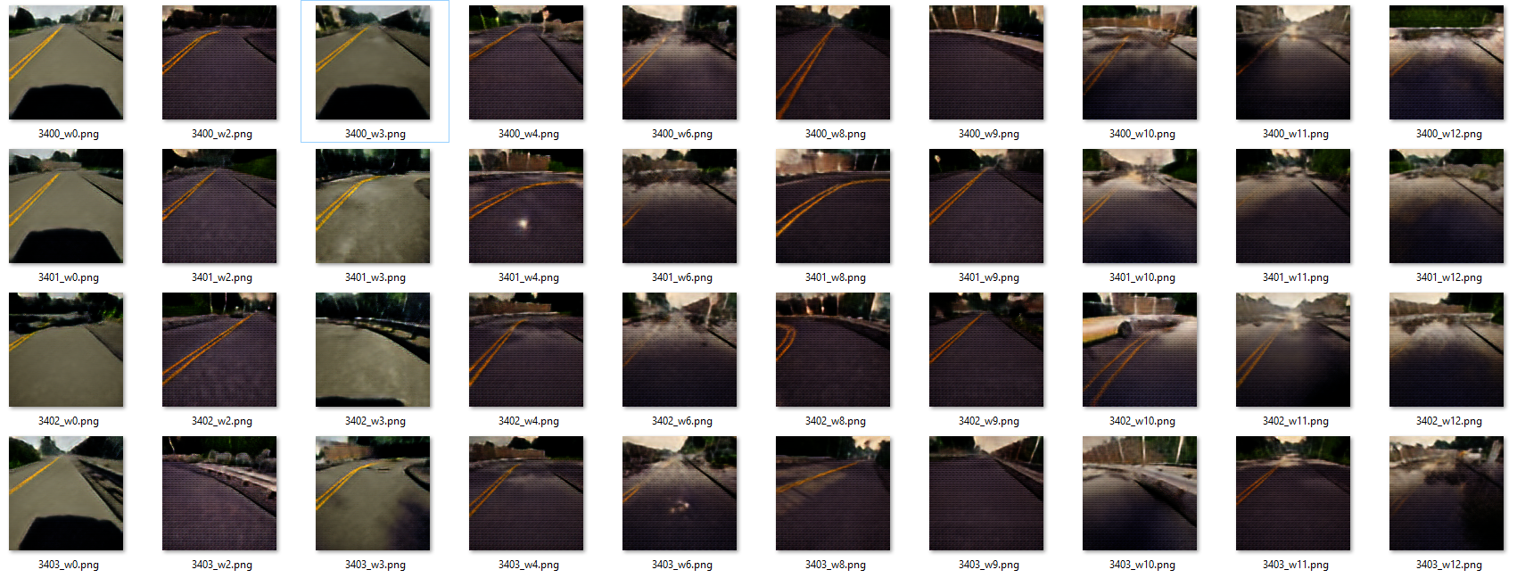
Recap: MUNIT didn‘t work well
Original
source
Guide
Image

Slide 3
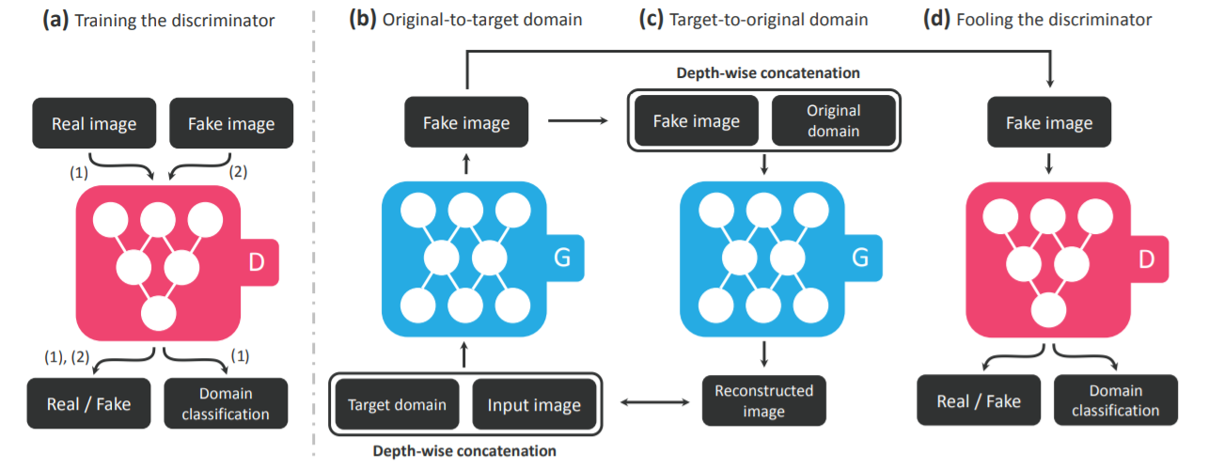
StarGAN
StarGAN works similar the way we wanted to modify CycleGAN. It extends the RGB channels with a one-hot-encoded channel. Moreover the discriminator is extended to do domain classification as well.

Slide 4
What we did
Trained StarGAN on the simulated dataset
It worked well, so we continued with real world dataset: Oxford Robotcar Dataset
Preprocessed Oxford Robotcar Dataset
Trained StarGAN on Oxford Robotcar Dataset

Slide 5
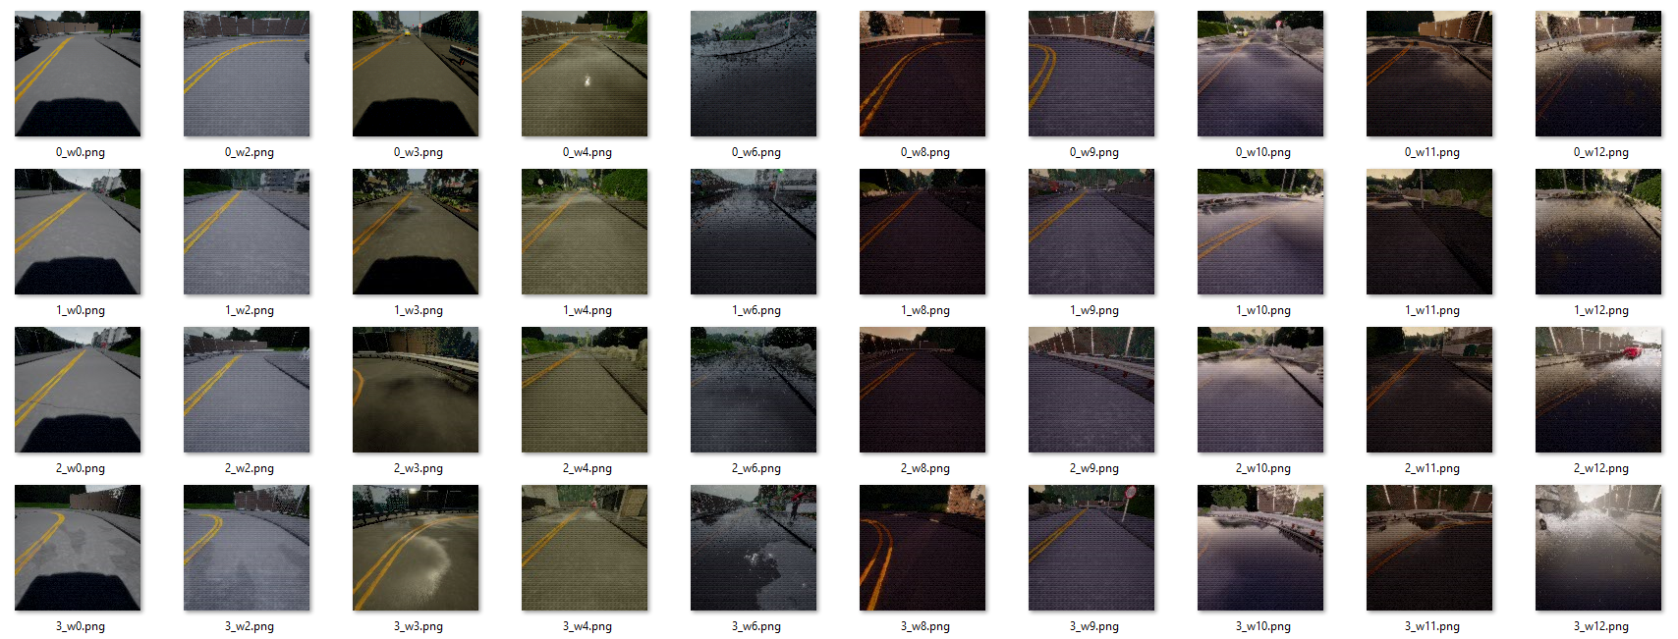
The Dataset

Slide 6
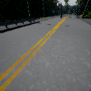




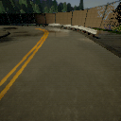



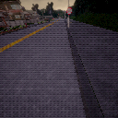
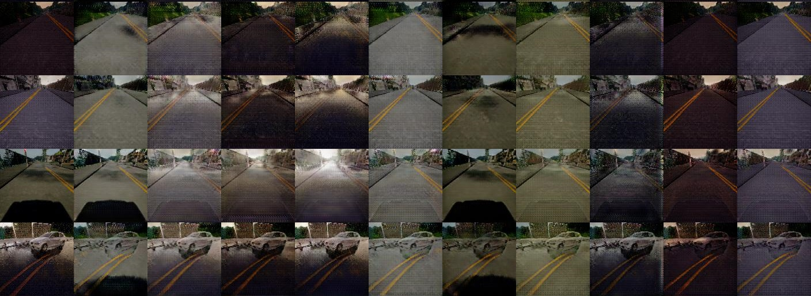
Results on simulated Dataset
Desired
Domain
Source
Image

Slide 7
Evaluation Simulated Dataset
The results in general are very good
Colors are all correct
Rain on the floor is also generated, though not very well
Caveats:
w0 and w3 contain shadows of the car in the training dataset, the model also generates them during testing
The model cannot deal well with rare objects (e.g. cars, shadows)
Resolution is not very high

Slide 8
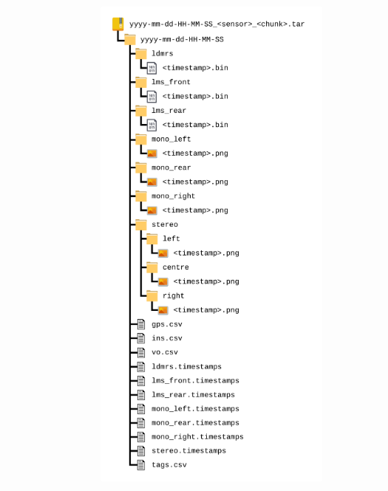
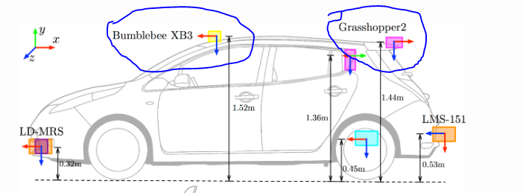
Oxford Robot Dataset

Slide 9
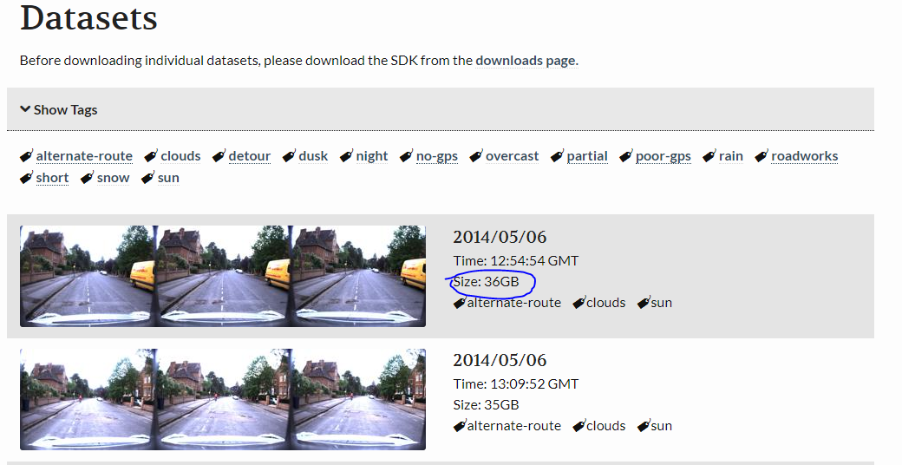
Oxford Robot

Slide 10
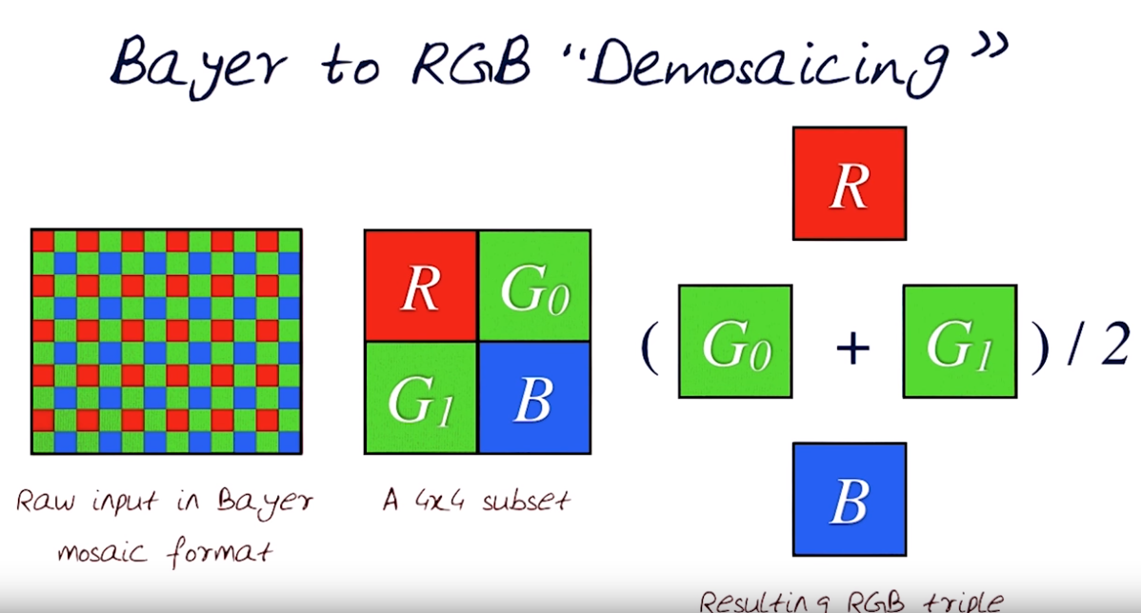
Raw Bayer Format

Slide 11
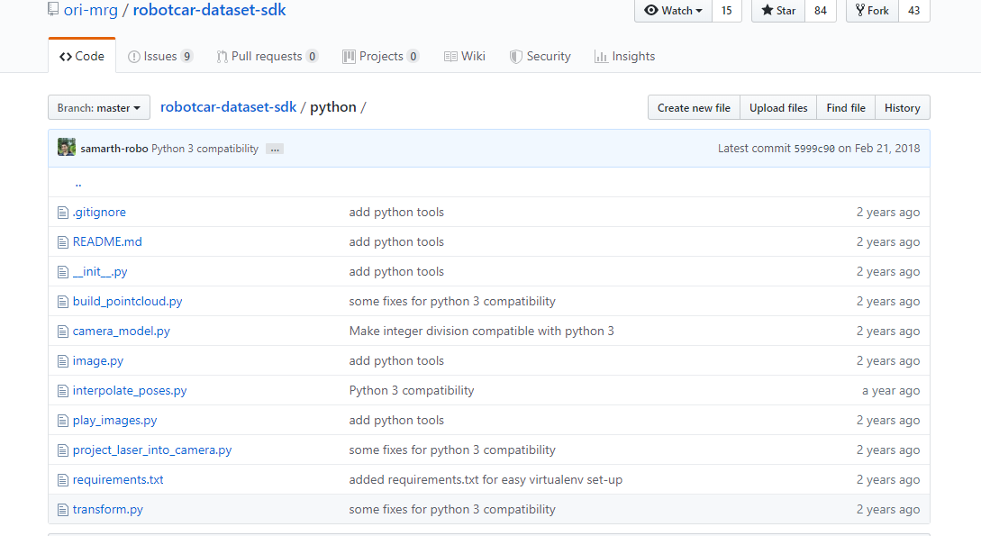
Oxford Robot Dataset SDK

Slide 12
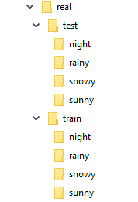
Oxford Robot Dataset
Too many images
Very High Resolution
In a wierd Folder Structure
Our Solution
python Dataprocessor.py --count 3000 --source test/cgan/ --destination augmented/ --test-split 0.2 -resize 256 –source-suffix ""
python Dataprocessor.py --count 1000 --source robocardata/sunny/stereo/centre/ --destination real/ --test-split 0.2 -resize 256 –source-suffix stereo/centre/

Slide 13
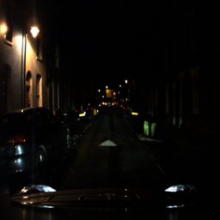
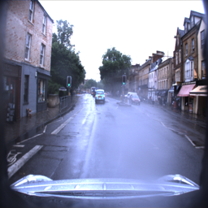
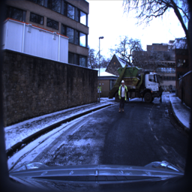
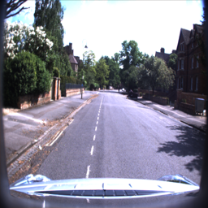
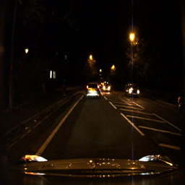
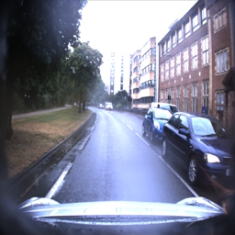
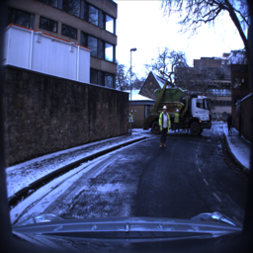
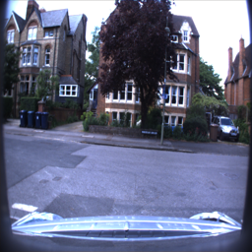
Examples of Oxford Robotcar Dataset
We picked four weather conditions which are ideally as different as possible:
Night
Rainy
Snowy
Sunny

Slide 14
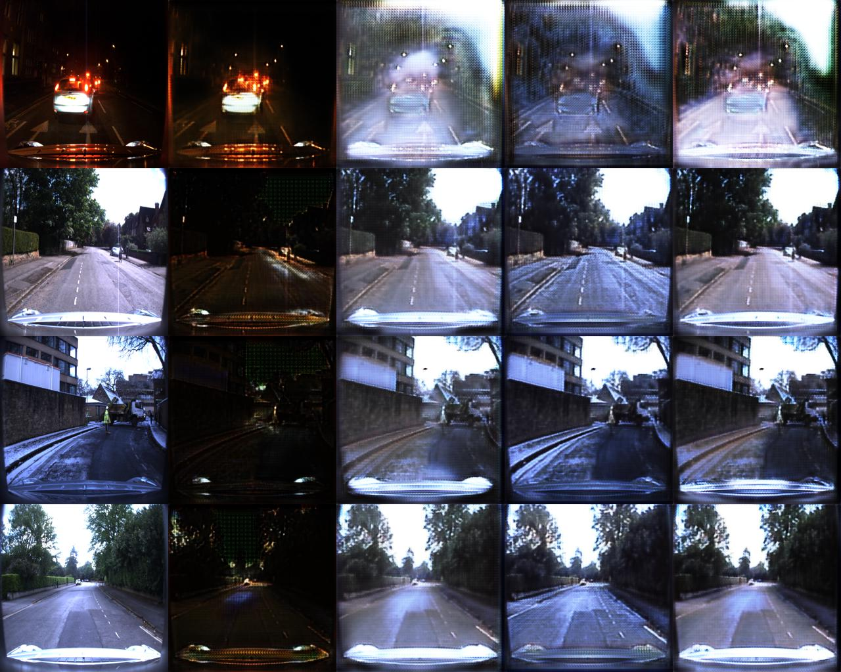
Training Results
4000 images
200000 Iterations
All trained models available on Gitlab

Slide 15
What Next
Work on generating better dataset (Rainy images and Sunny are some what similar)
Retraining on more data
Figure out the ability to control class transformation in a continuous fashion.

